Slide 1
Neural Network Methods in Natural Language Processing
Ch1 Introduction
延浩然 吴晨

Slide 2
Outline
The Challenges of Natural Language Processing
Neural Networks and Deep Learning
Deep Learning in NLP
Success Stories
Coverage and Organization

Slide 3
The Challenges of Natural Language Processing

Slide 4
Natural Language Processing
Natural Language Processing
Natural Language Processing is the field of designing methods and algorithms that take as input or produce as output unstructured, natural language data.

Slide 5
Human language
Human language
Highly Ambiguous
I ate pizza with friends
I ate pizza with olives
Highly Variable
I ate pizza with friends
Friends and I shared some pizza
Changing and evolving
我和朋友吃披萨
我吃橄榄披萨
Same Expression

Slide 6
Natural Language Processing
人们善于理解、运用和创造语言，却不擅长
形式化的理解和描述语言的规则
使用计算机理解和产生语言

Slide 7

Supervised Machine Learning Methods
Supervised Machine Learning Methods 是运用在NLP中的典型方法
适用于规则难以覆盖，但人工标注数据相对简单的任务
eg. 文本分类
Sports
But which words provide what hints？
Politics
“抽特征”是一个相对不确定
且困难的任务
Gossip
Economy

Slide 8
Properties of Natural Language
自然语言有如下三个特点
Discrete 离散化的
Compositional 组合化的
Sparse 稀疏的

Slide 9
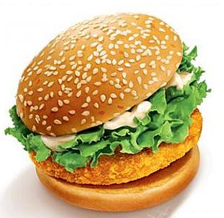
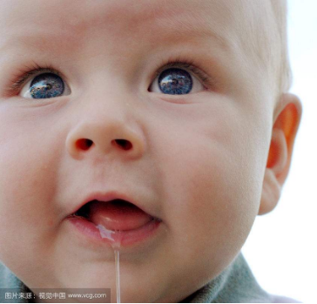
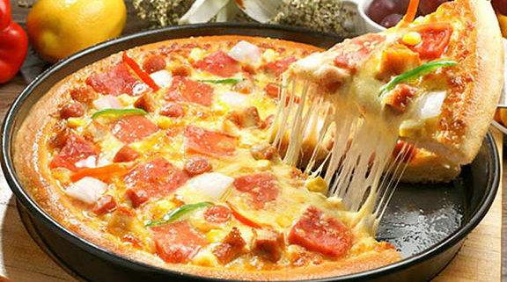

Discrete
Discrete
都是好吃的！
“hamburger”
“pizza”
意识中相近的概念在自然语言中却是完全离散化的符号
符号本身看不出任何的内在联系
啥玩意儿哟

Slide 10
Compositional
Compositional
eg.make
make up
Can I make up the history exam I missed?
Bruce makes up his mind to stop gambling and go find a job finally
字母组成词，词组成短语和句子，一个短语的意思可能比组成它的词的含义更多
在理解一段文字时，需要从整体的角度去考量

Slide 11
Sparse
前两个特性的结合
各种离散的语言单位组合成了千变万化的表达，形成了十分庞大的句子/篇章数目，造成了数据极大的稀疏性
例如，十年前报纸上的人名、商标名、公司名、科技名词等主题，都与现在大不相同
给通过样本去学习的方法增加了难度

Slide 12
Neural Network And Deep Learning
Notes:
2014年，开始从线性分类器转向非线性神经网络

Slide 13
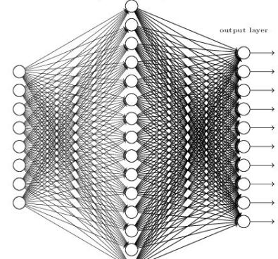
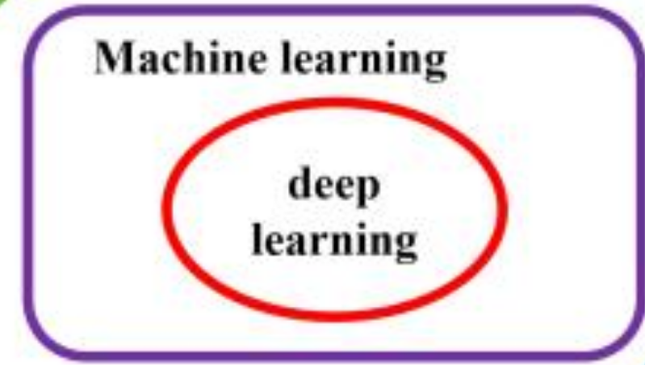
Deep Learning

Slide 14
Deep Learning
深度学习不仅可以做预测，更可以学习数据的正确表示
这使得多数的NLP问题变得更为容易
将离散的符号映射到低维空间的向量上
人 ： 设计网络结构，提供合适的输入-输出样本和适当的编码
神经网络 ：自动的学会合理的数据表示

Slide 15
Deep Learning in NLP

Slide 16
Deep Learning in NLP
a major component: embedding layer
将孤立的符号变成可操作的数学对象
离散的符号 连续的向量空间
eg. 向量间的距离可以用来衡量词（语言单元）之间的距离
减轻了离散化和数据稀疏性的问题

Slide 17
Deep Learning in NLP
Two major kinds of neural network architectures:
Feed-forward networks(Convolutional )
Recurrent/recursive networks

Slide 18
Feed forward networks
Feed-forward networks
Multi-layer perceptrons
Fixed sized input/variable length input disregarded the order of the elements
Nonlinearity + word embedding superior classification accuracy
Convolutional feed-forward networks
Arbitrarily sized inputs
Excel at extracting local patterns that are sensitive to word order
Identifying indicative phrases from long sentences or documents

Slide 19
Recurrent neural networks
Recurrent neural networks
用于生成序列化的数据的信息化表达
常作为后续网络的前处理单元
考虑了整个句子和语序，不受数据稀疏性的影响
在语言模型取得了令人瞩目的成果
RNN + Attention

Slide 20
Recursive neural networks
Recursive neural networks
Recurrent neural networks
对象从 sequence trees
适用于需要特定树形结构的应用场景，比如句法分析
句法树的生成

Slide 21
Deep Learning in NLP
Natural language problems : Structured
sequence-to-sequence
Language prediction problems are related
Shortage of labeled training data
Transfer learning
Semi-supervised learning

Slide 22
Success Stories

Slide 23
Success Stories
Fully connected feed-forward networks
Replace linear classifiers, result in great improvement
Language modeling; CCG supertagging; dialog state tracking;
pre-ordering for SMT; sentiment classification; factoid question answering
FC + beam search -> syntactic parsing; sequence tagging;

Slide 24
Success Stories
Convolutional neural networks
Useful for classification tasks which needs strong local clues
Document classification; short-text categorization; sentiment classification; relation extraction; event detection; semantic role labeling; question answering;

Slide 25
Success Stories
Recurrent and recursive neural networks
Word with structured data with arbitrary sizes (sequences, trees)
Language modeling; sequence tagging; machine translation; parsing; response generation; relation extraction;

Slide 26
Coverage And Organization

Slide 27
Coverage And Organization
Four Parts
Part I : The basic learning machinery
Part II : Language data connects the machinery introduced in part I
Part III: Specialized convolutional and recurrent networks
Part IV: Advanced topics

Slide 28
Coverage And Organization
Part I basic learning machinery
Chapter 2 : basic concepts of supervised learning
Chapter 3 : from linear model to multi-layer perceptrons
Chapter 4: feed-forward neural networks
Chapter 5 : neural network training

Slide 29
Coverage And Organization
Part II working with natural language data
Chapter 6 : common NLP problems and features
Chapter 7 : case studies of NLP features
Chapter 8: connects cp6、7 with neural networks
Chapter 9 : language modeling
Chapter 10 : pre-trained word representations
Chapter 11 : using word embeddings
Chapter 12 : case study of a task-specific feed-forward network tailored for the Natural Language Inference

Slide 30
Coverage And Organization
Part III specialized architectures
Chapter 13 : convolutional neural networks
Chapter 14 : RNN abstraction
Chapter 15: simple RNN、LSTM、GRU
Chapter 16 : examples of modeling with RNN abstraction
Chapter 17 : conditioned generation framework

Slide 31
Coverage And Organization
Part IV advanced and non-core topics
Chapter 18 : recursive neural networks
Chapter 19 : structured output prediction
Chapter 20 : multi-task and semi-supervised learning

Slide 32
谢谢！

